Slide 1
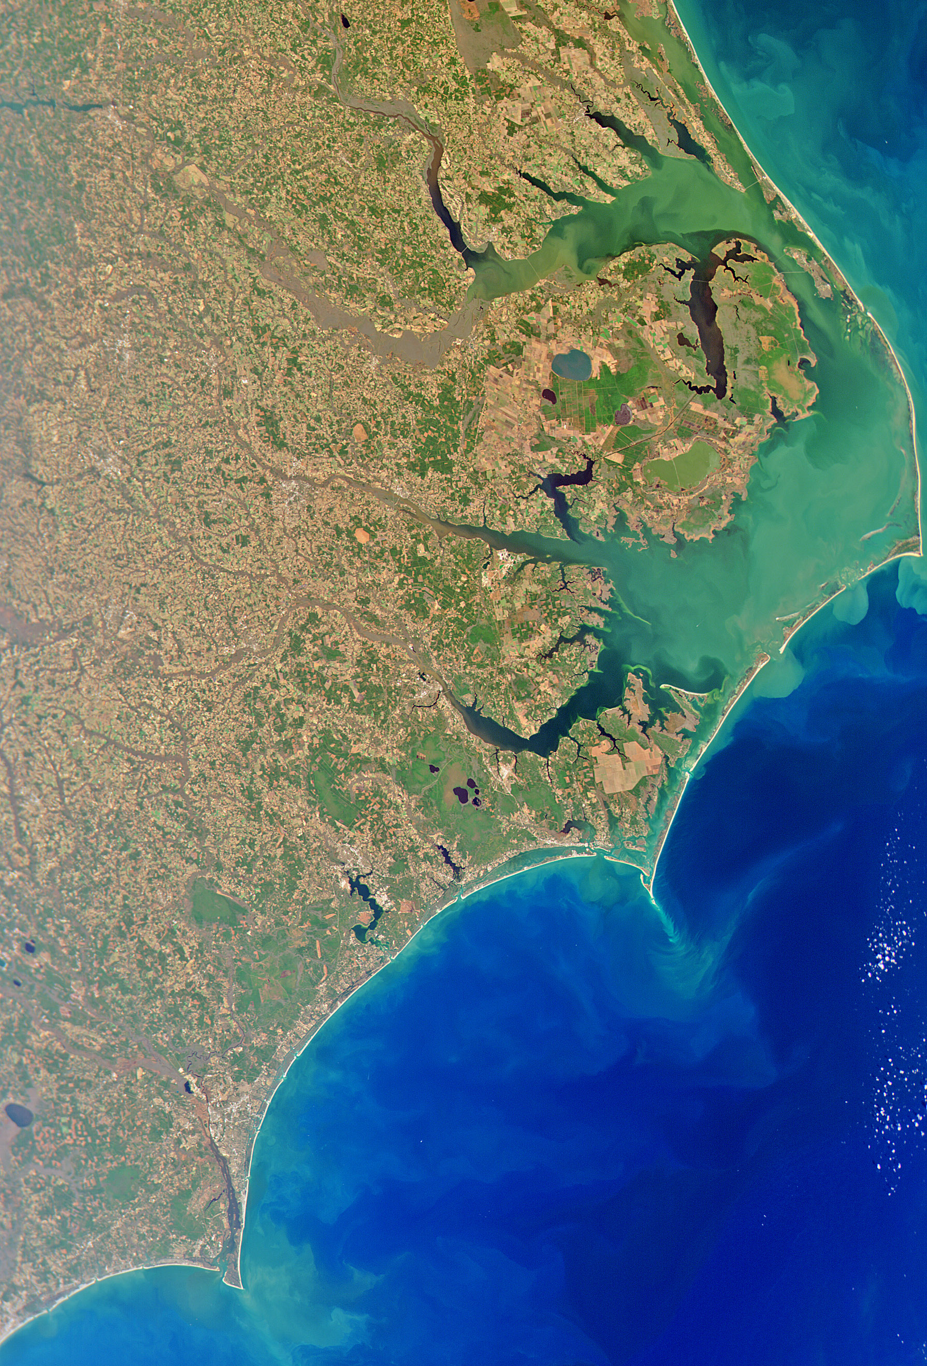
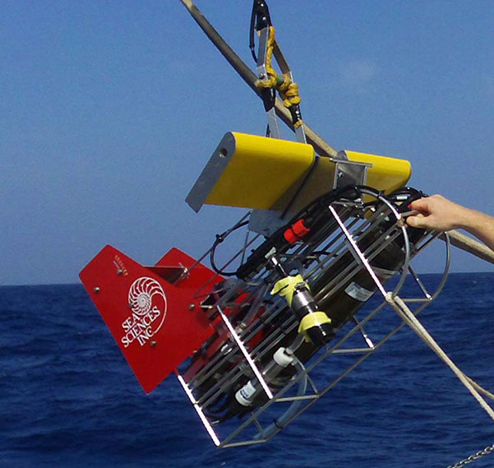
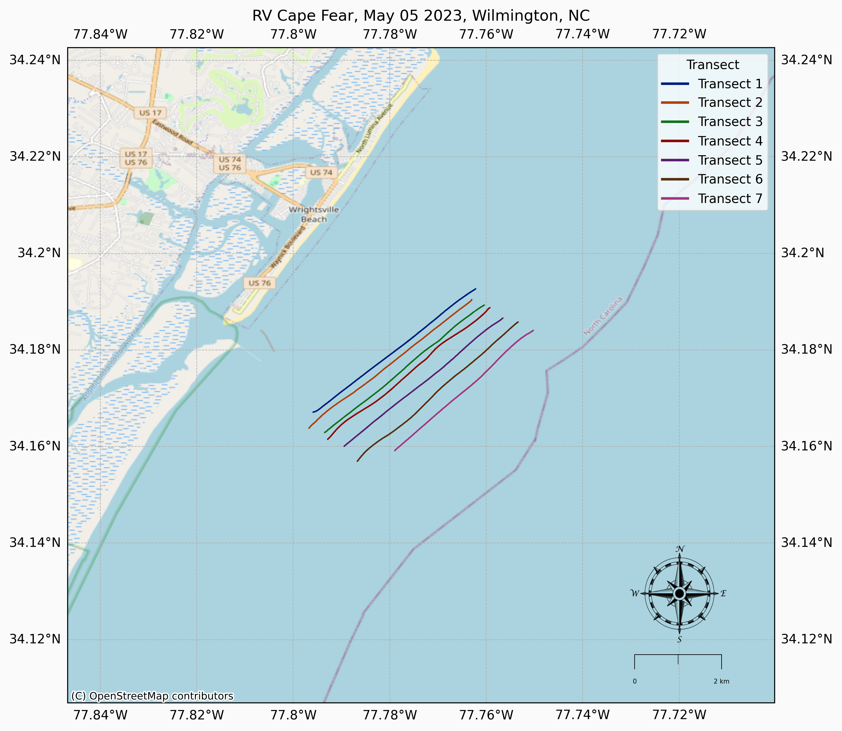
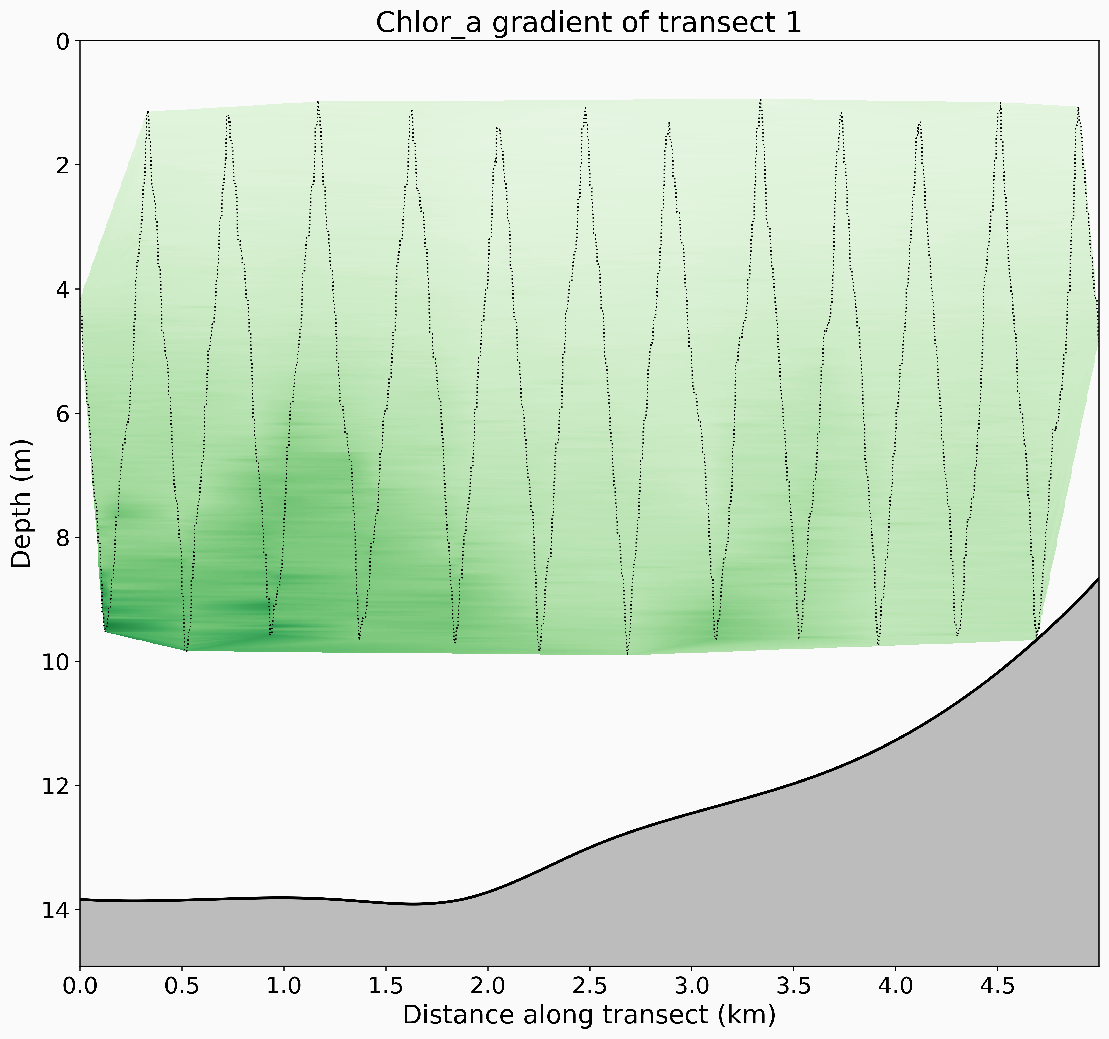
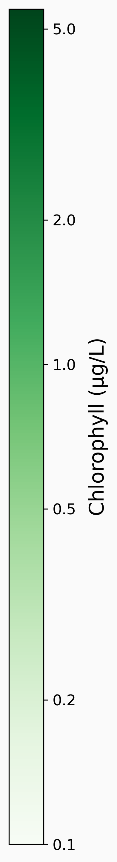
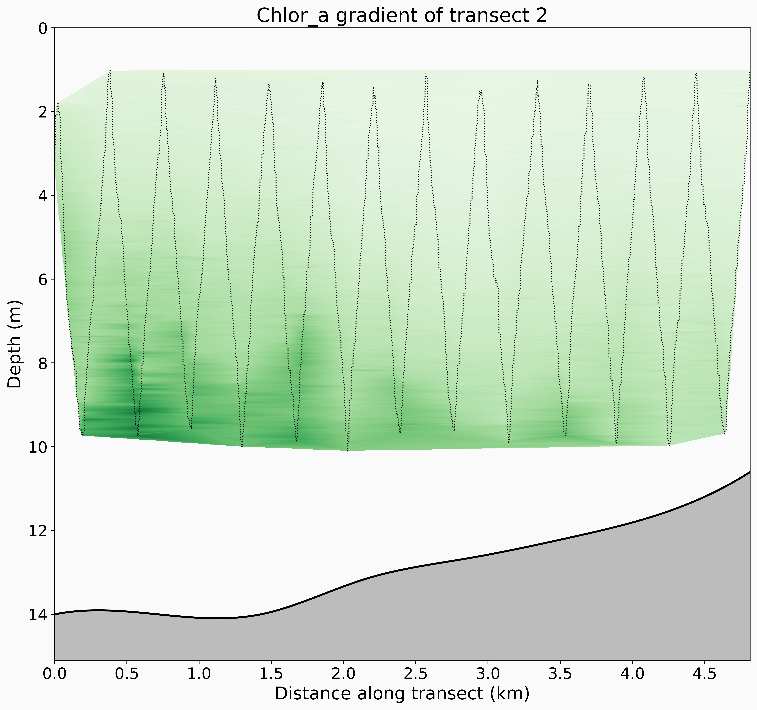
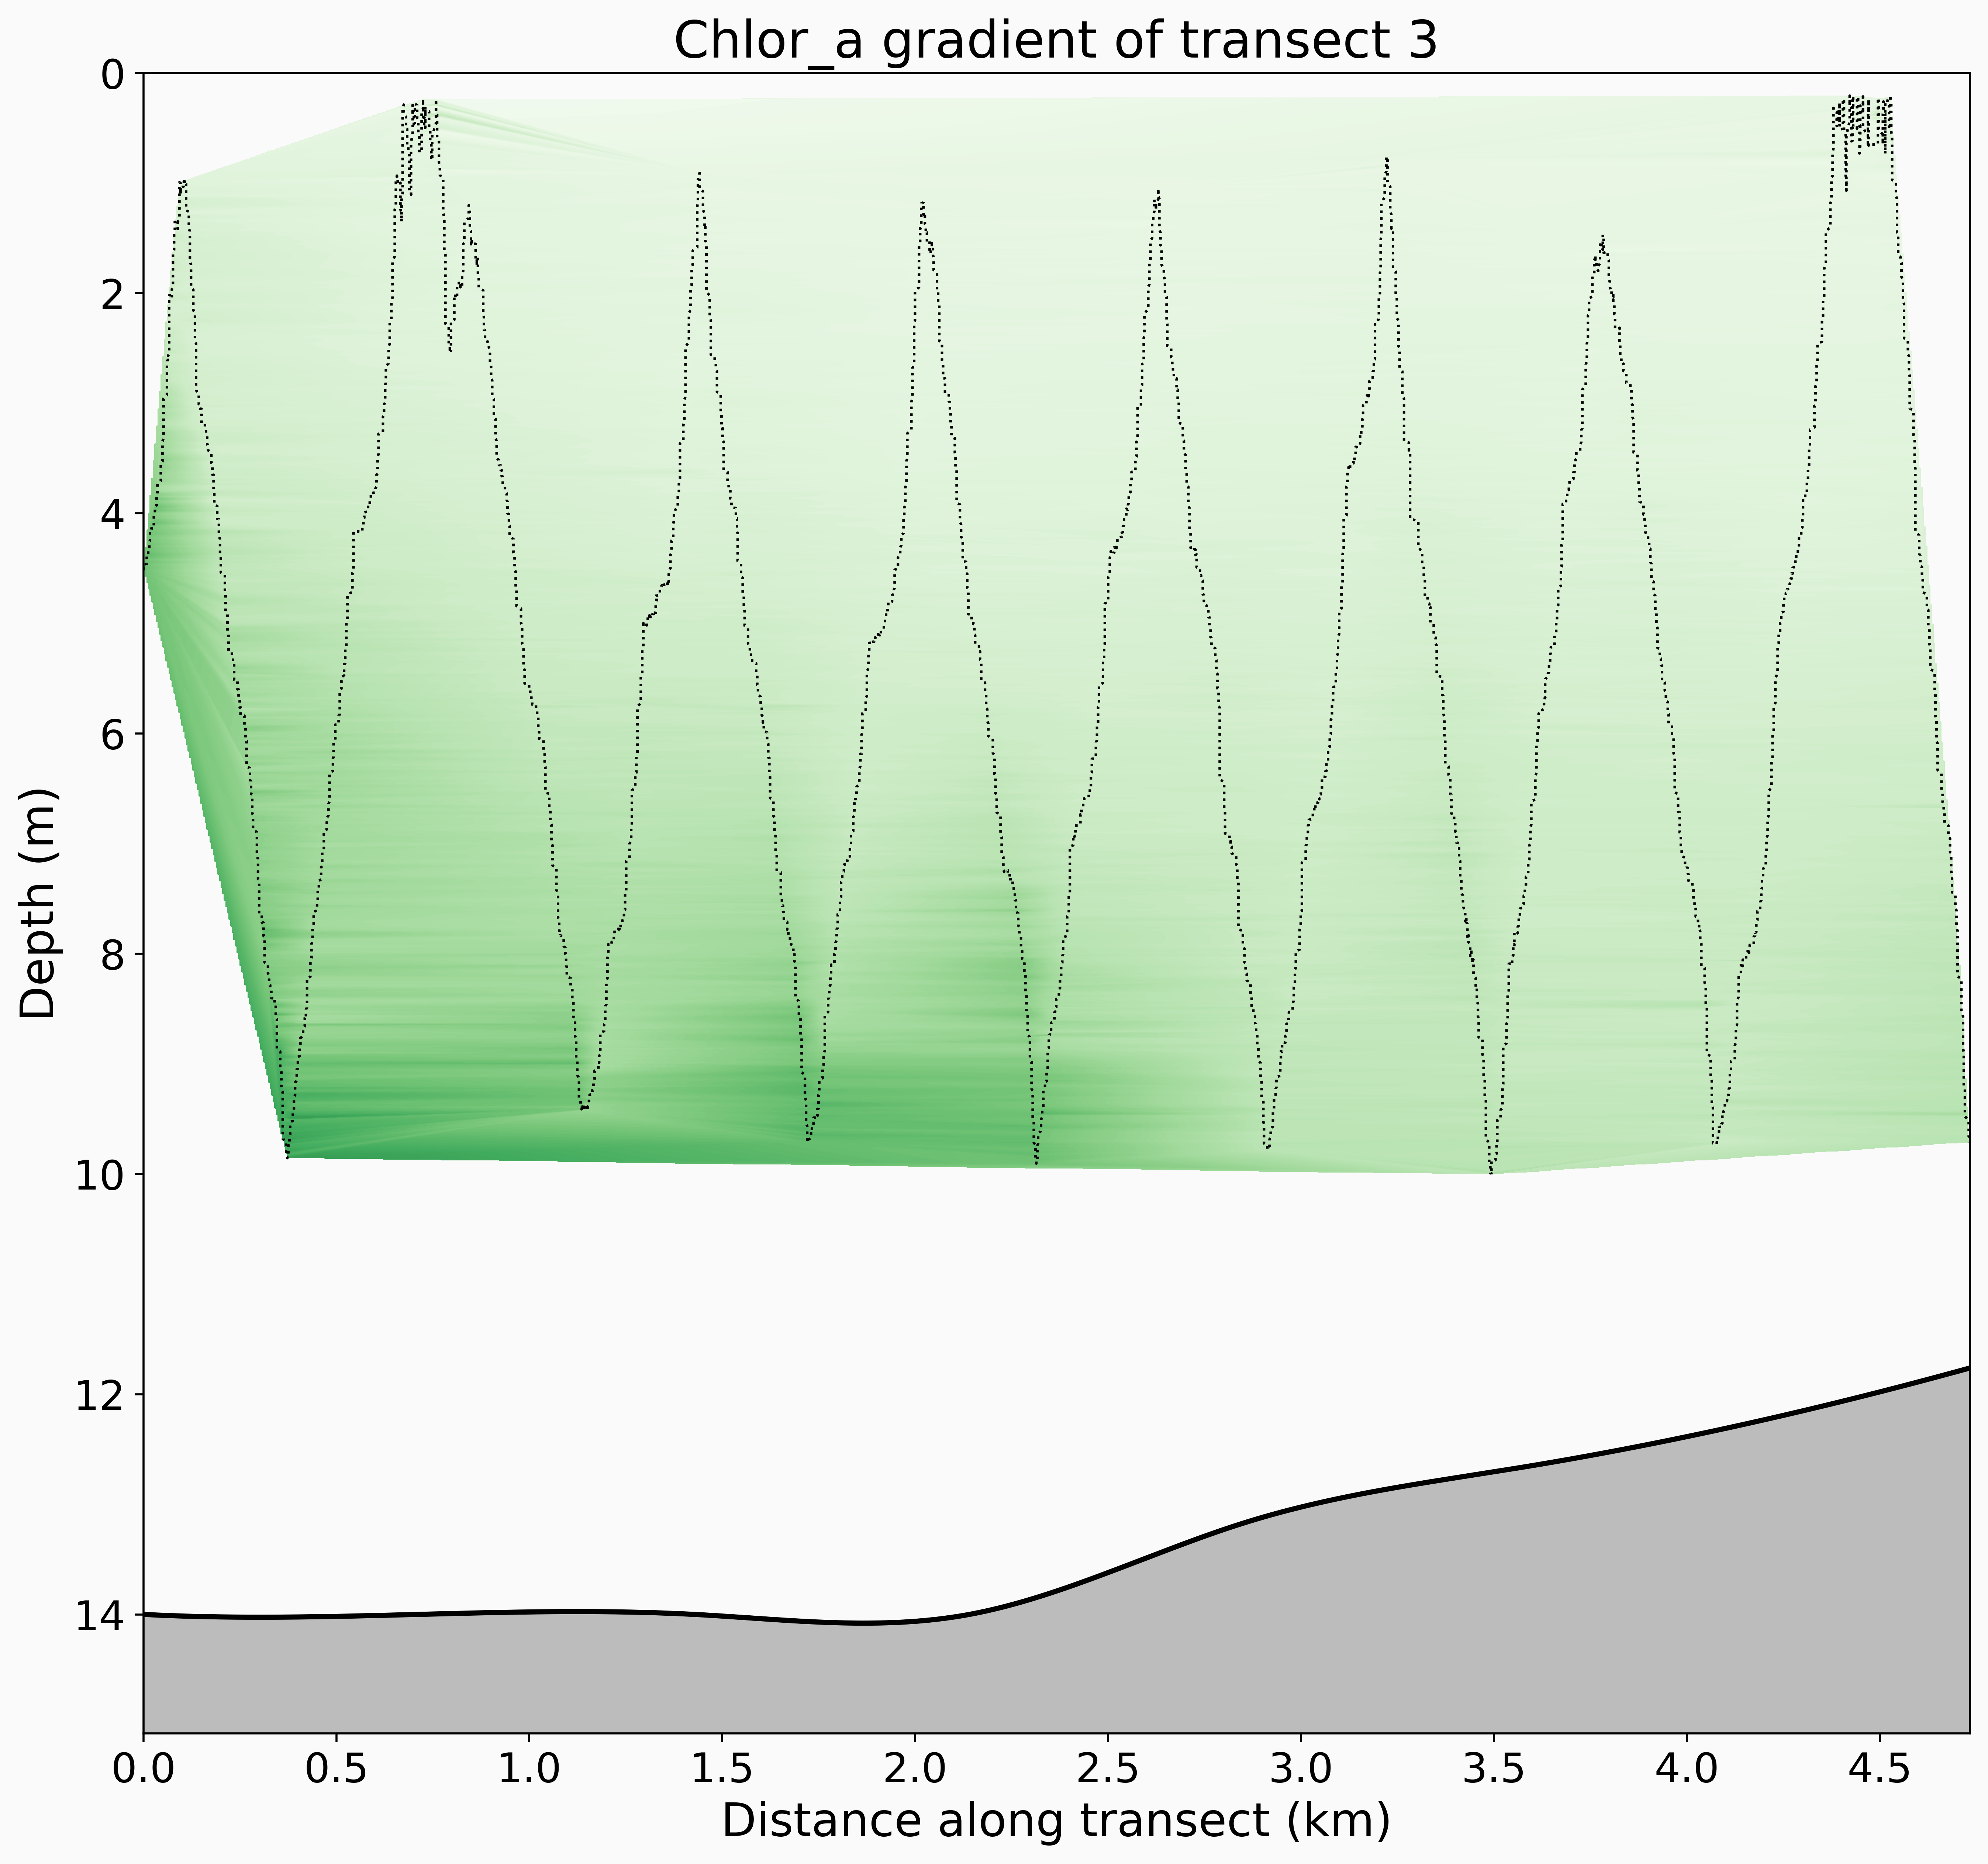
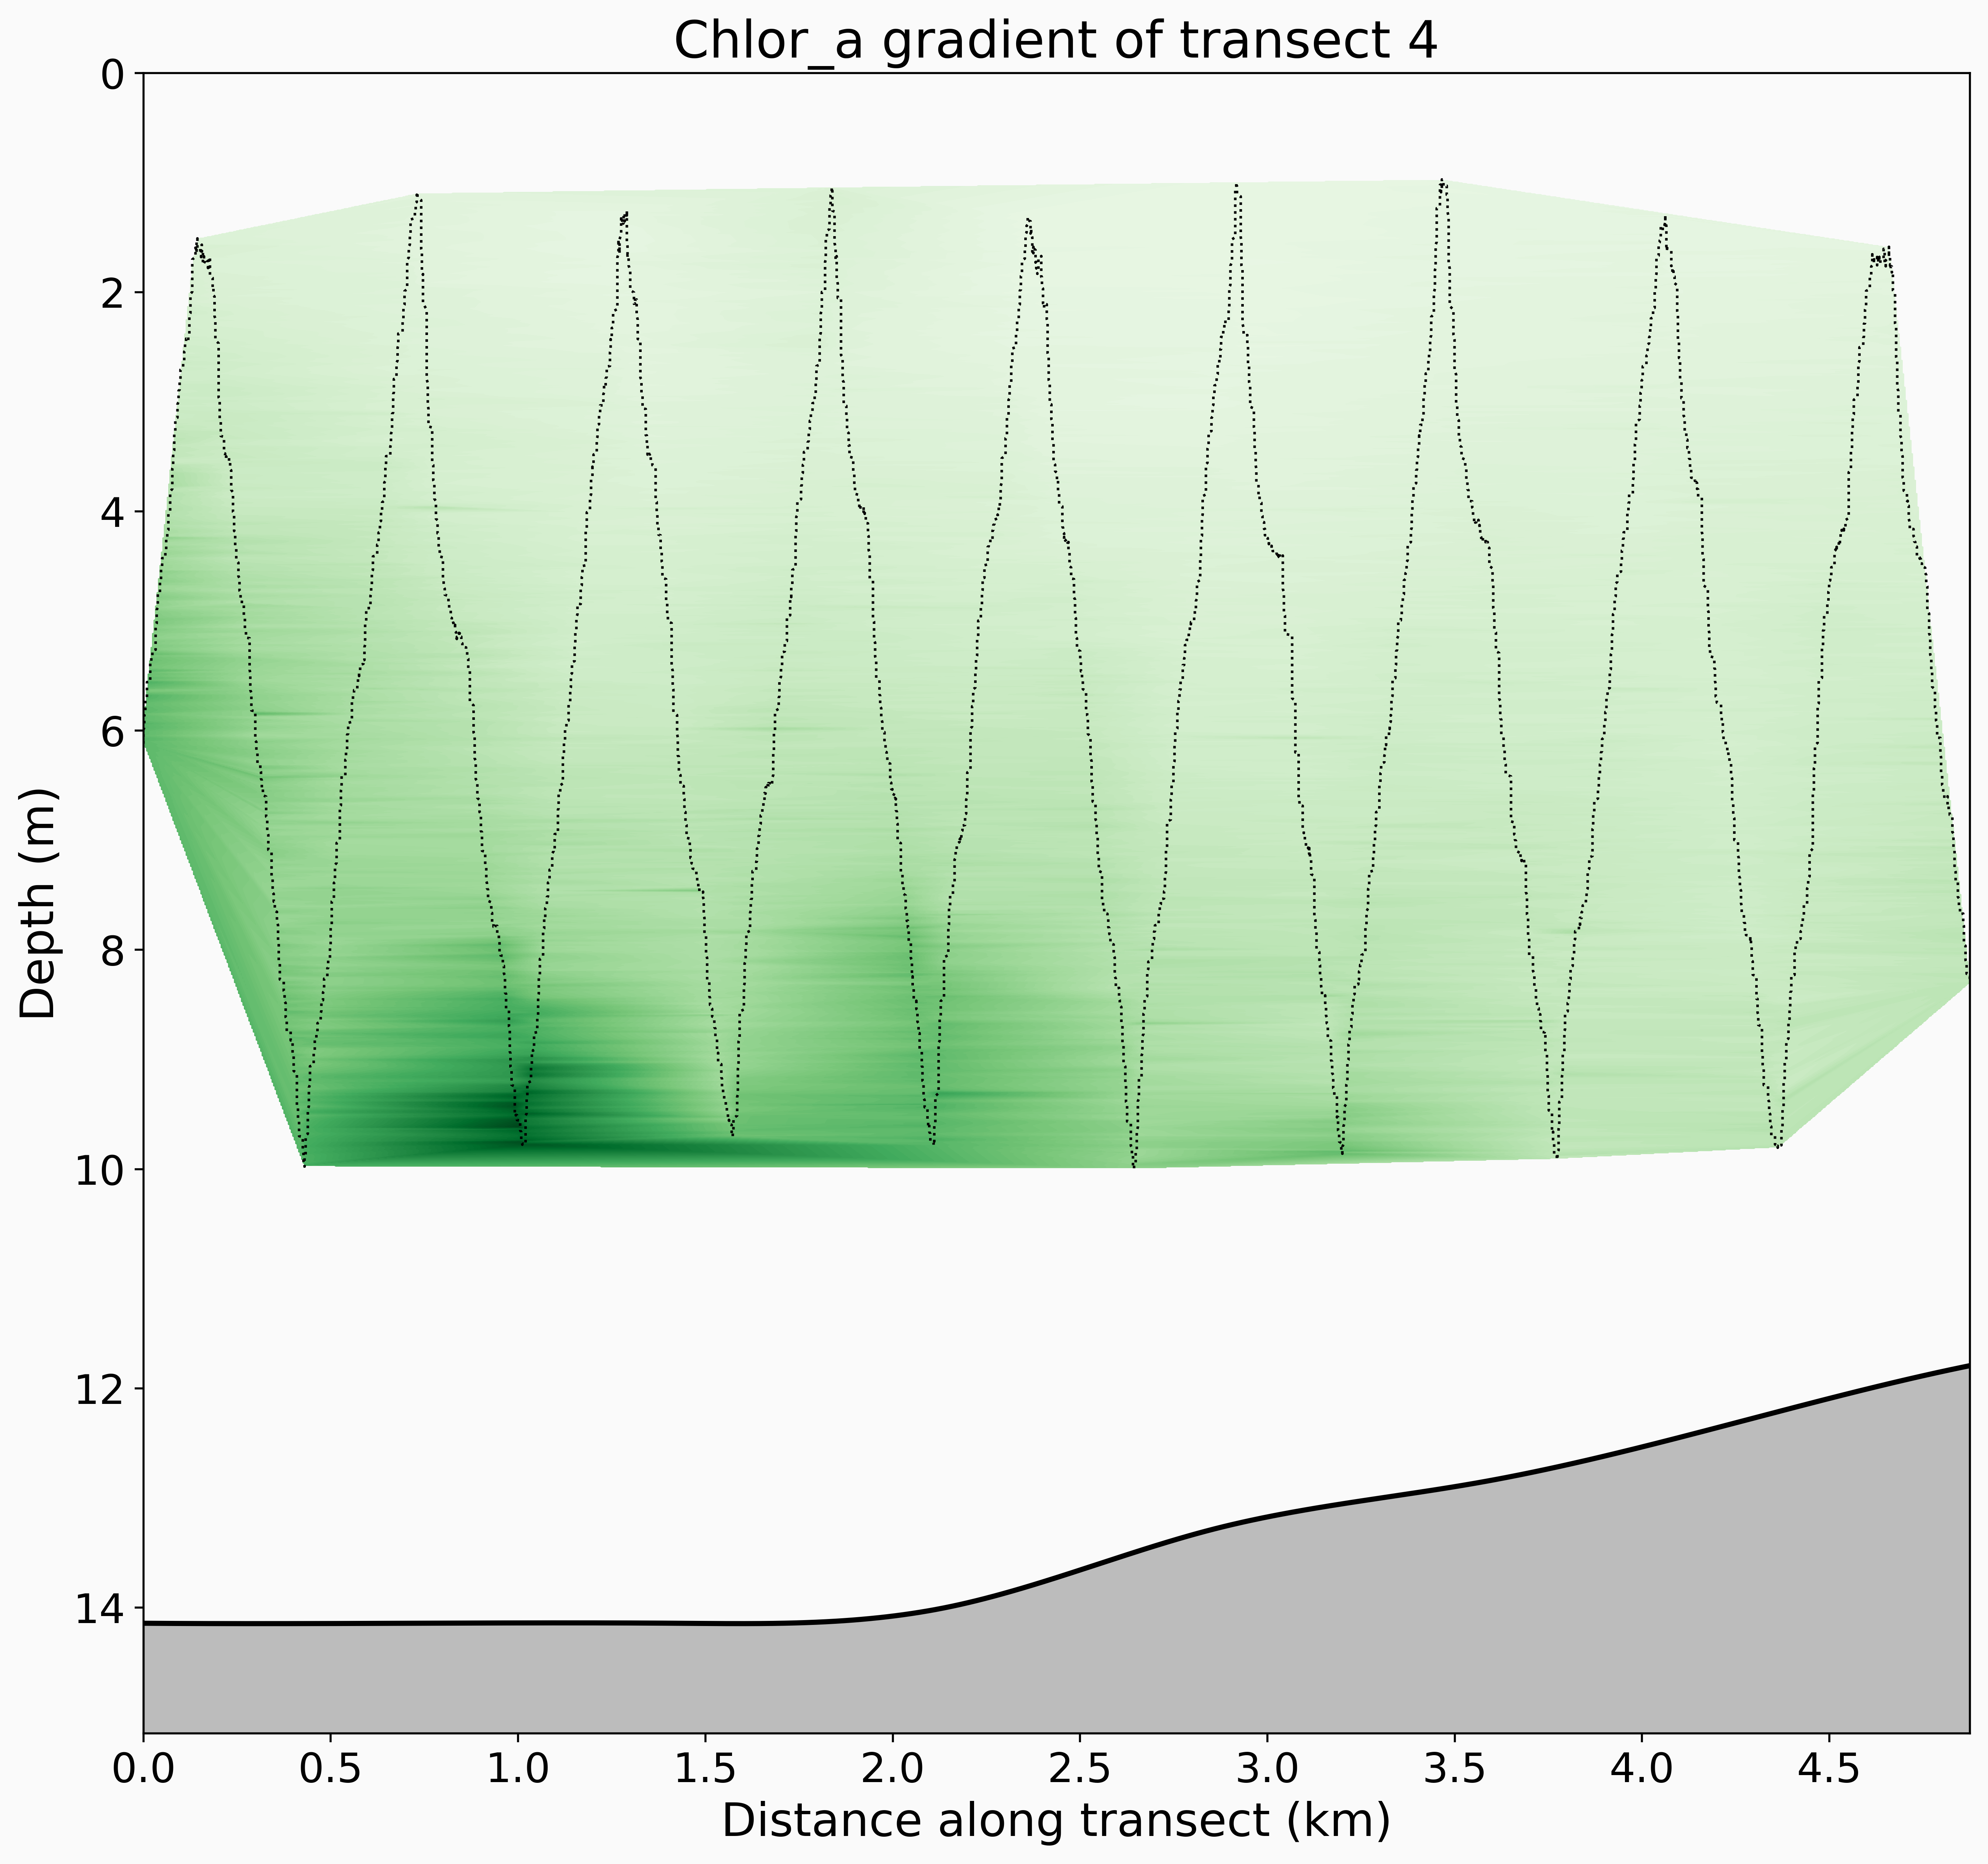
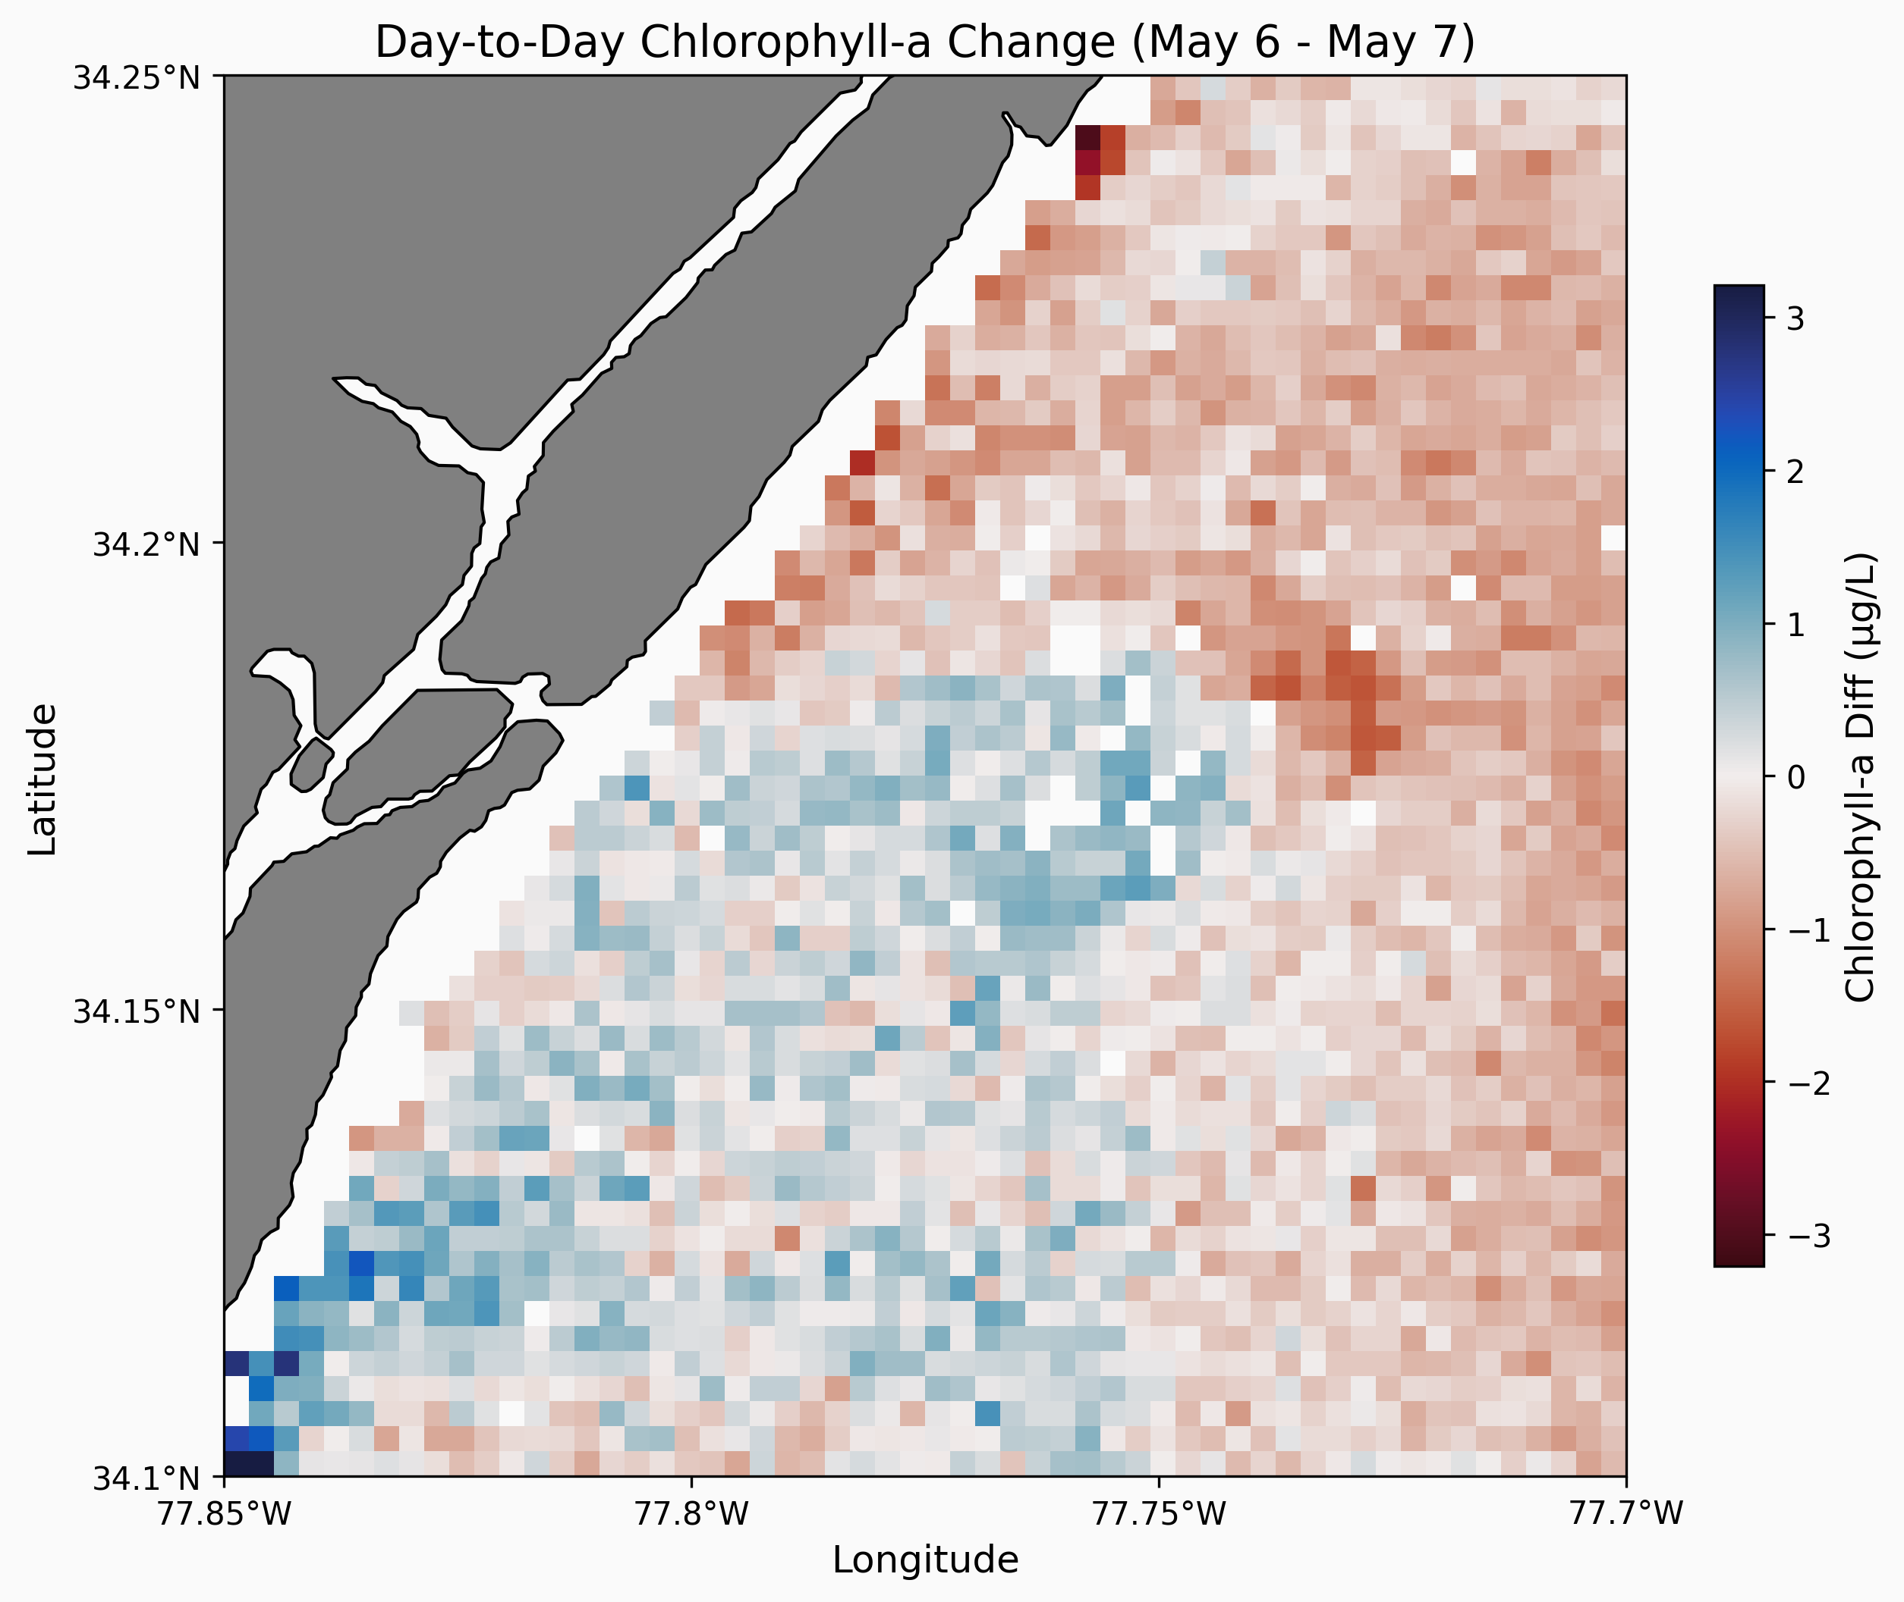
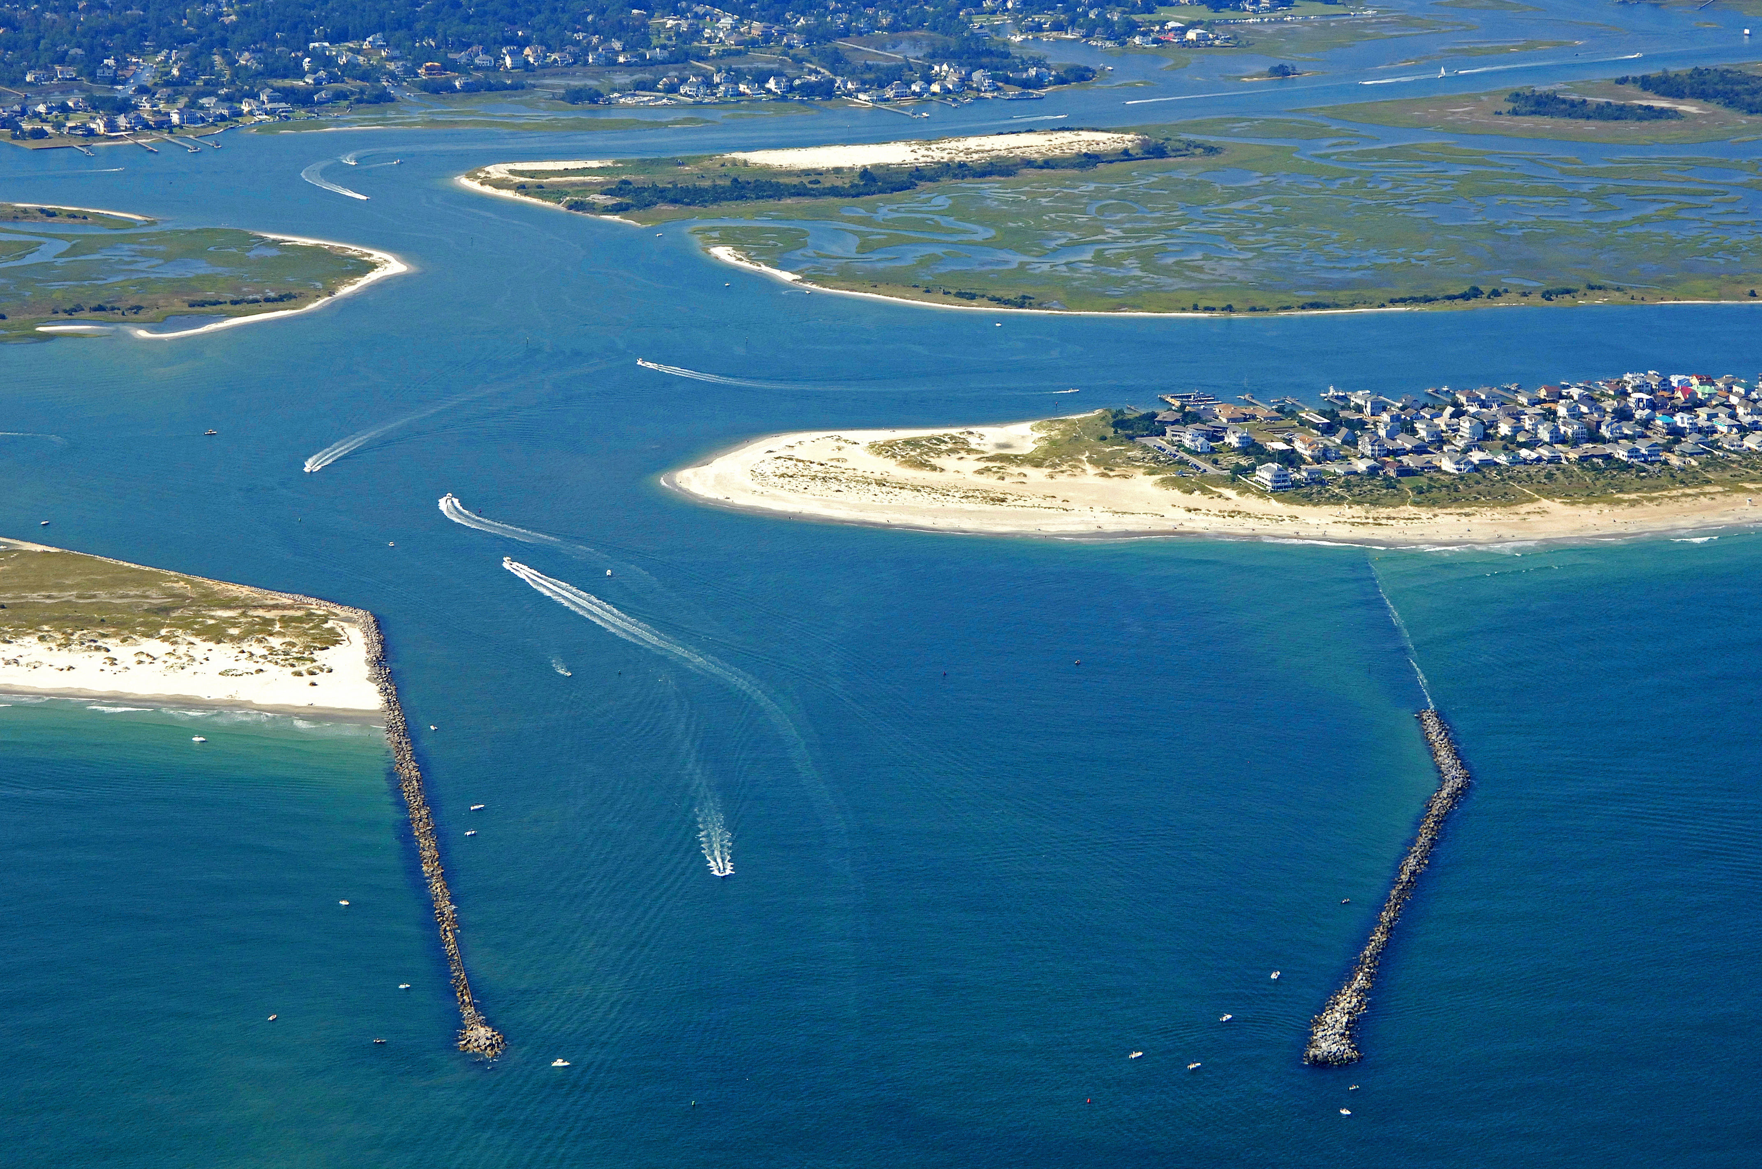
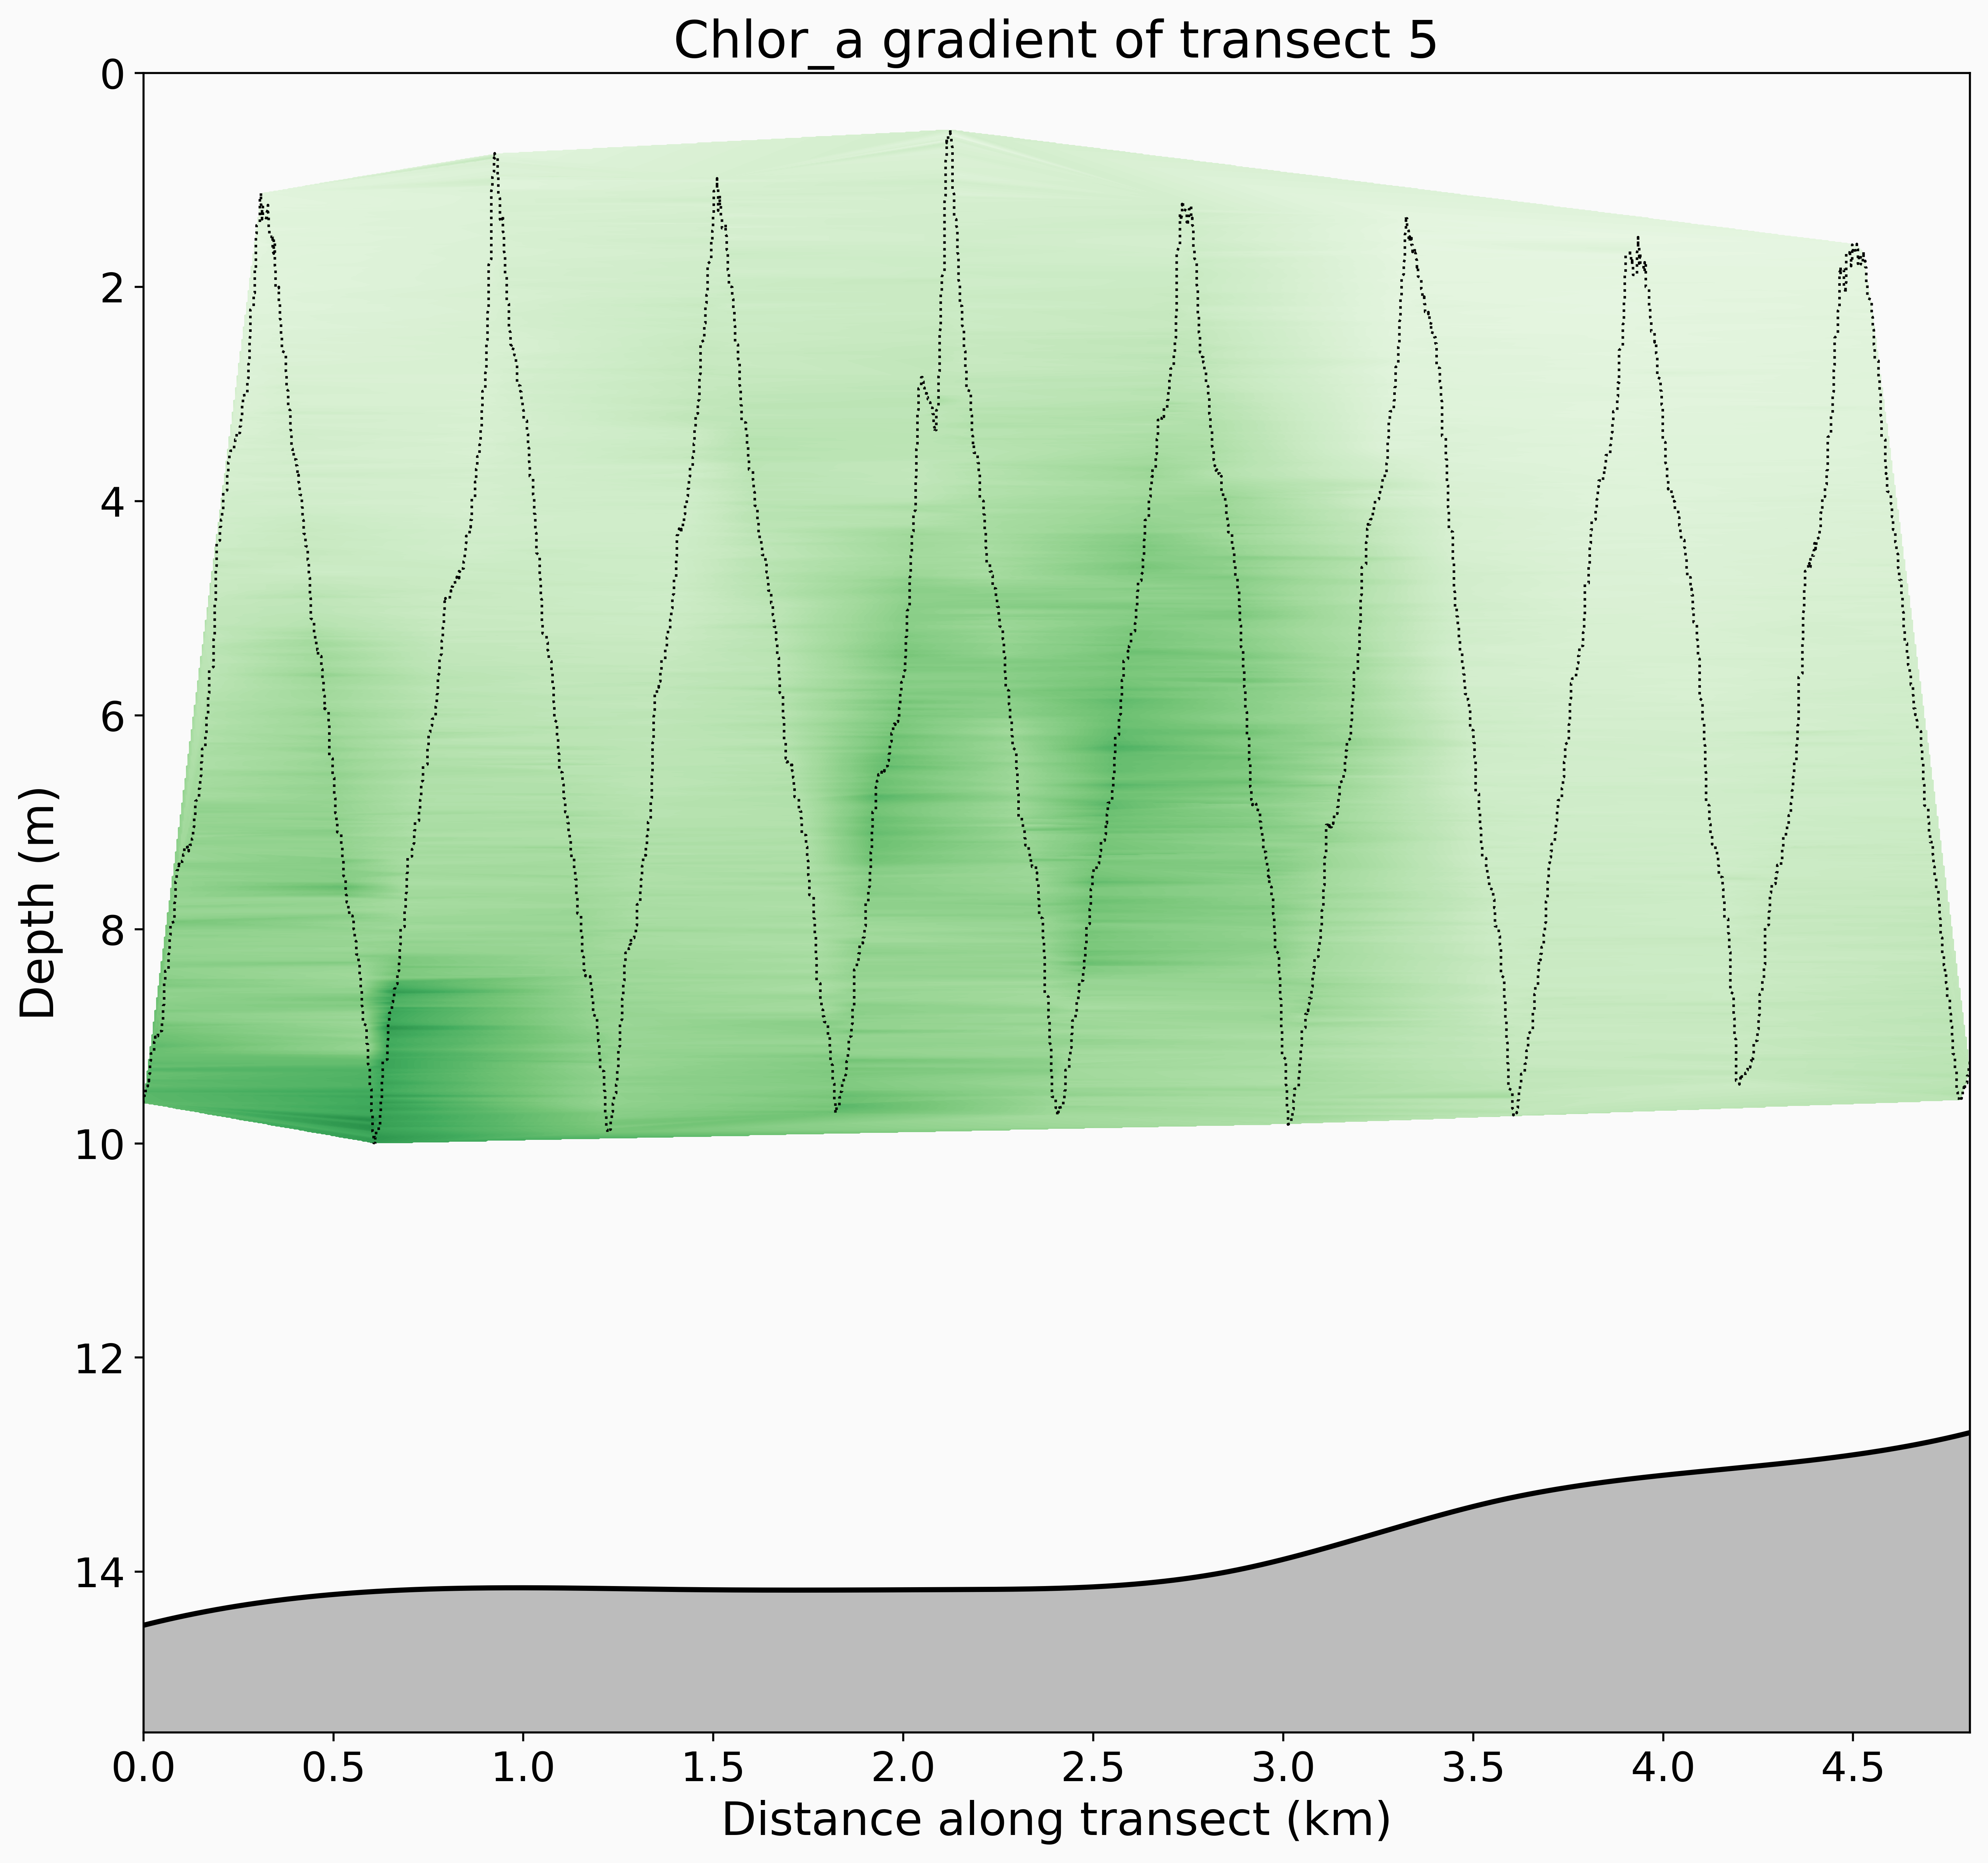
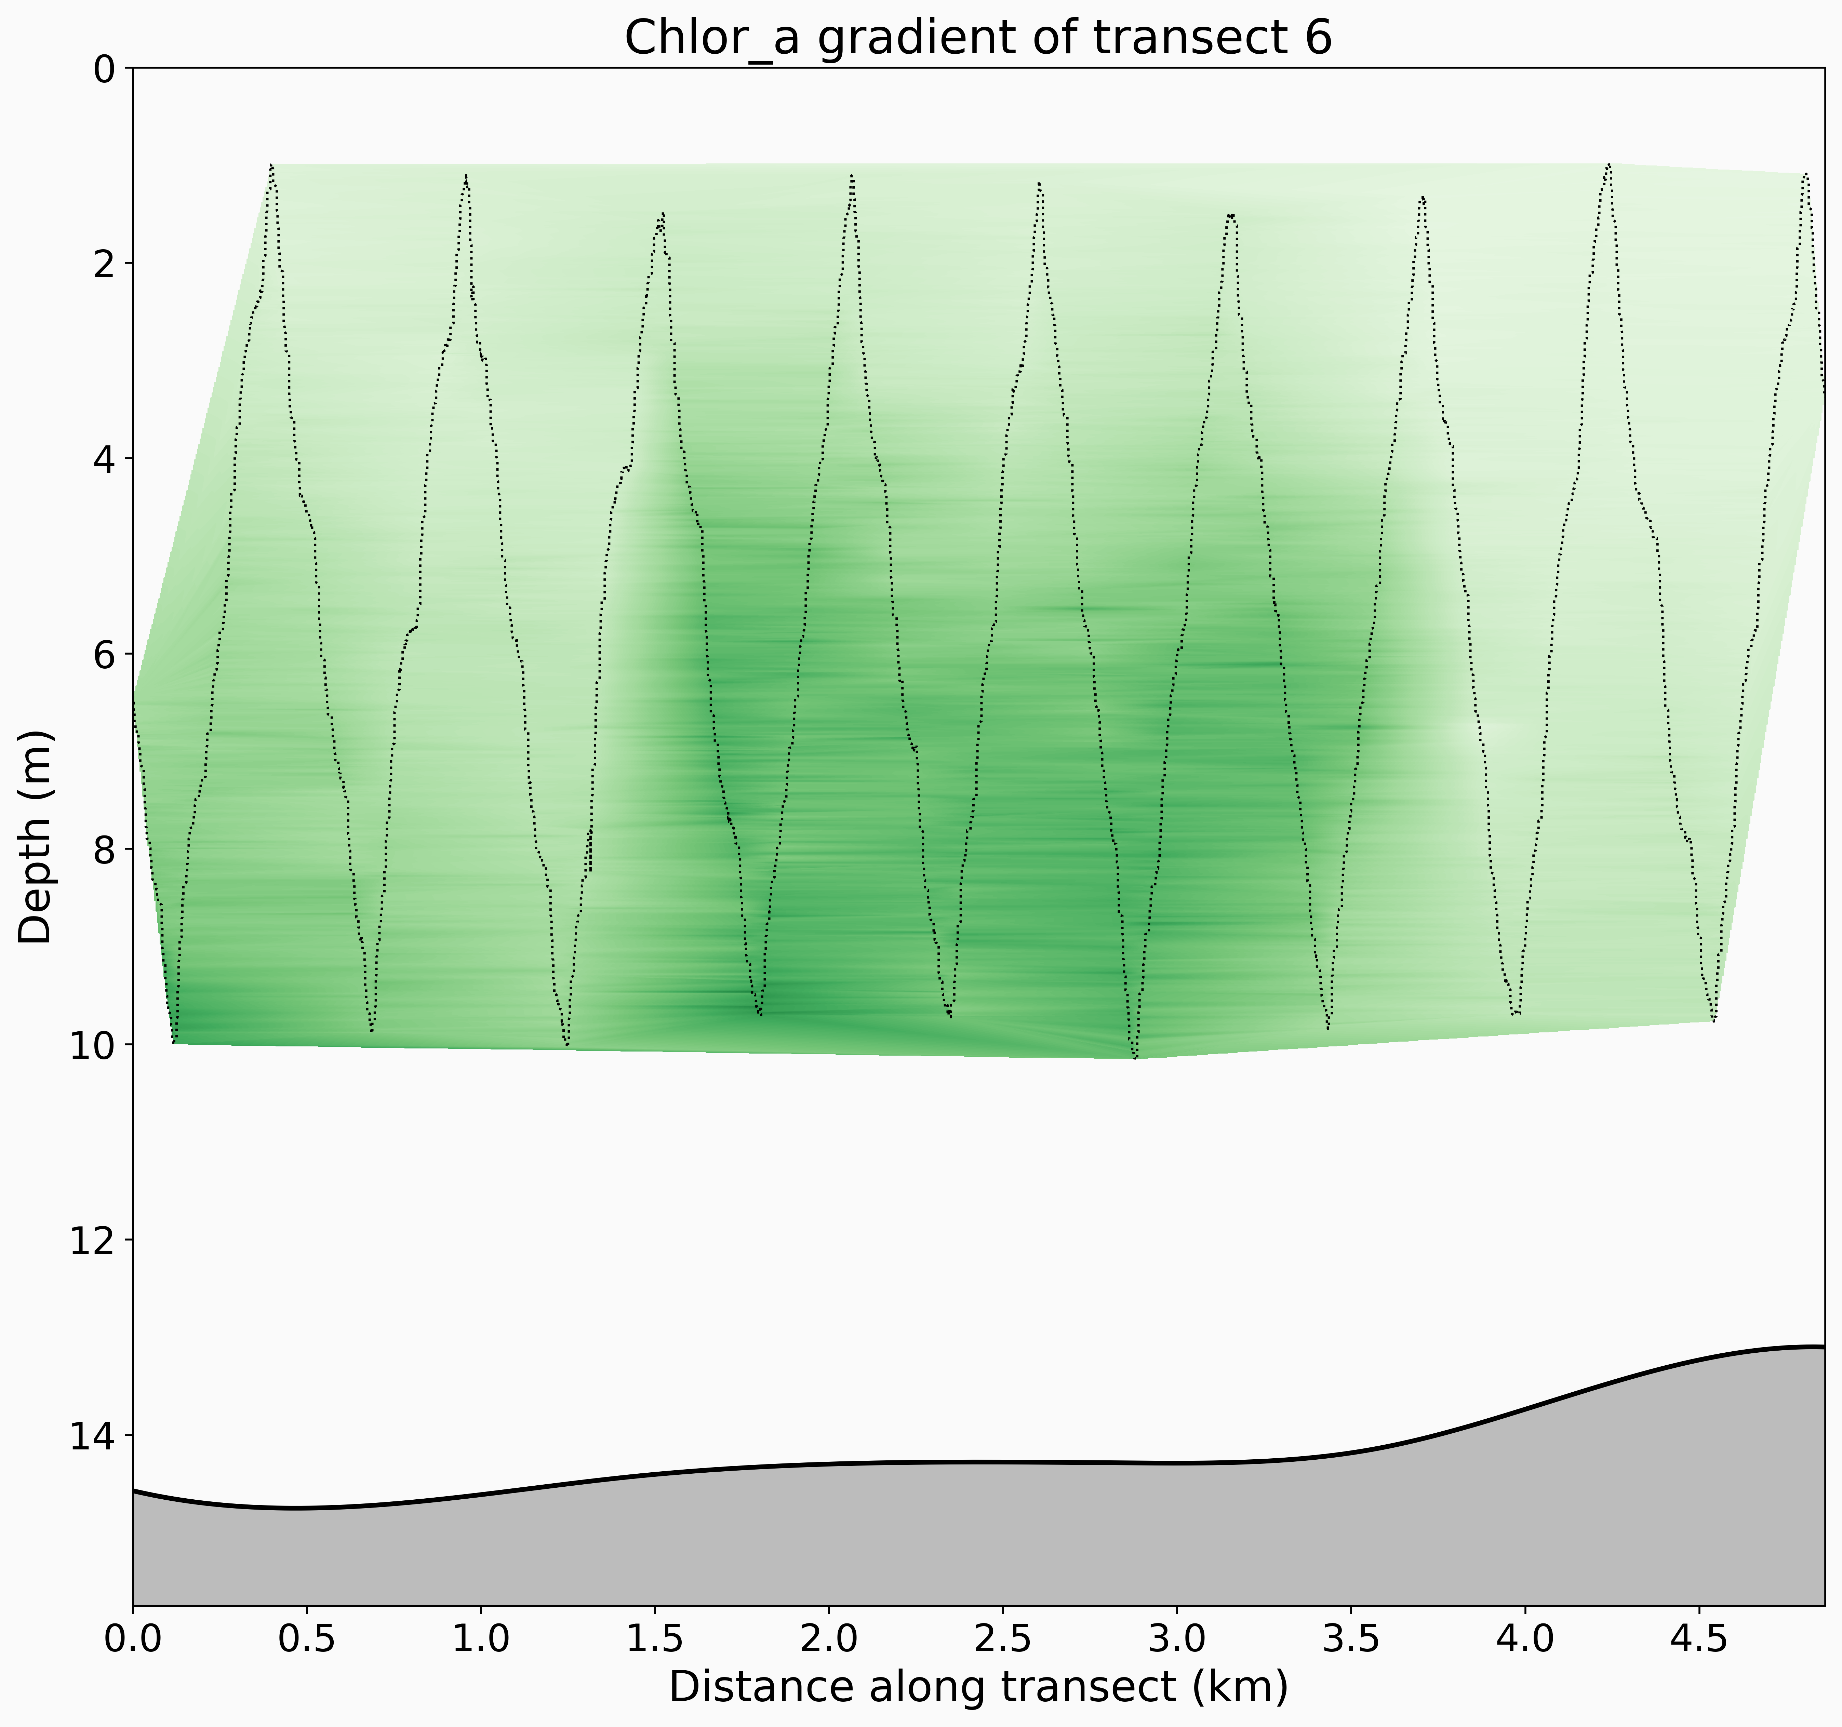
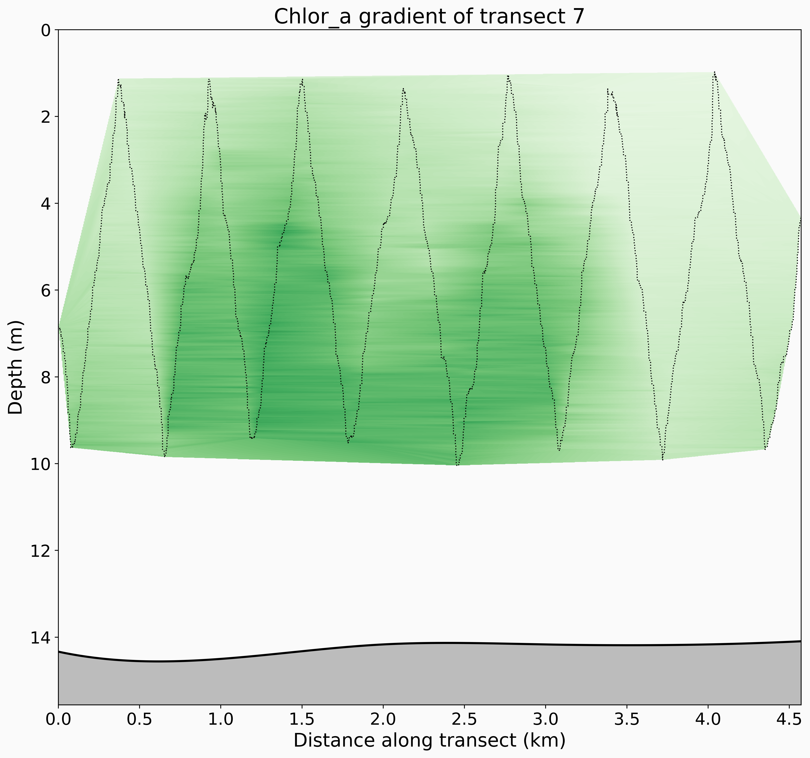
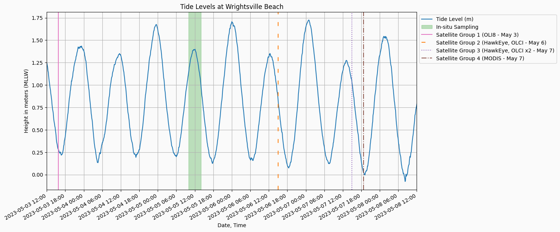
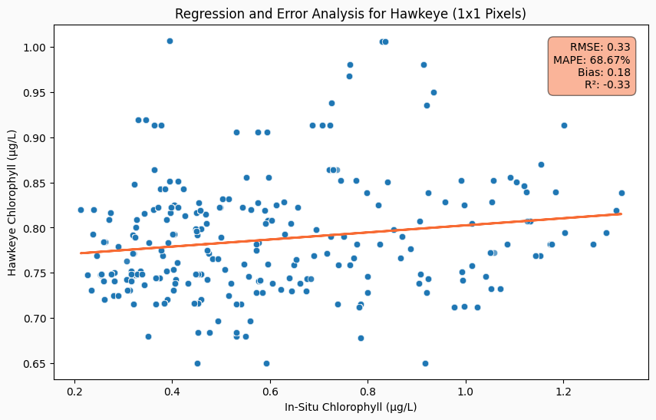
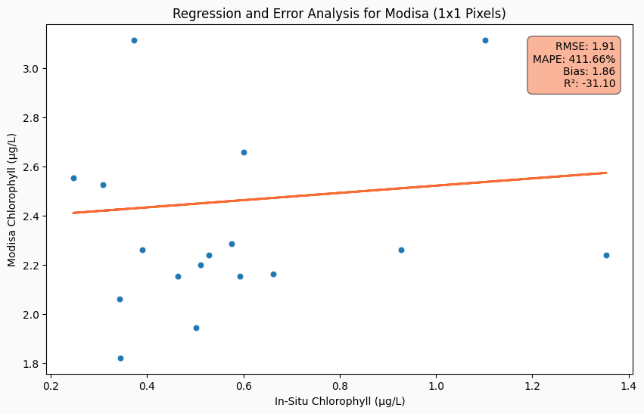
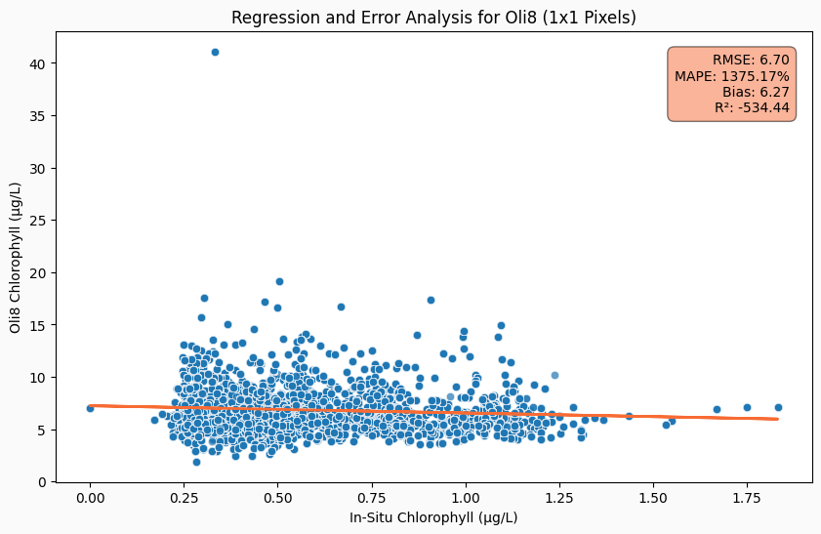
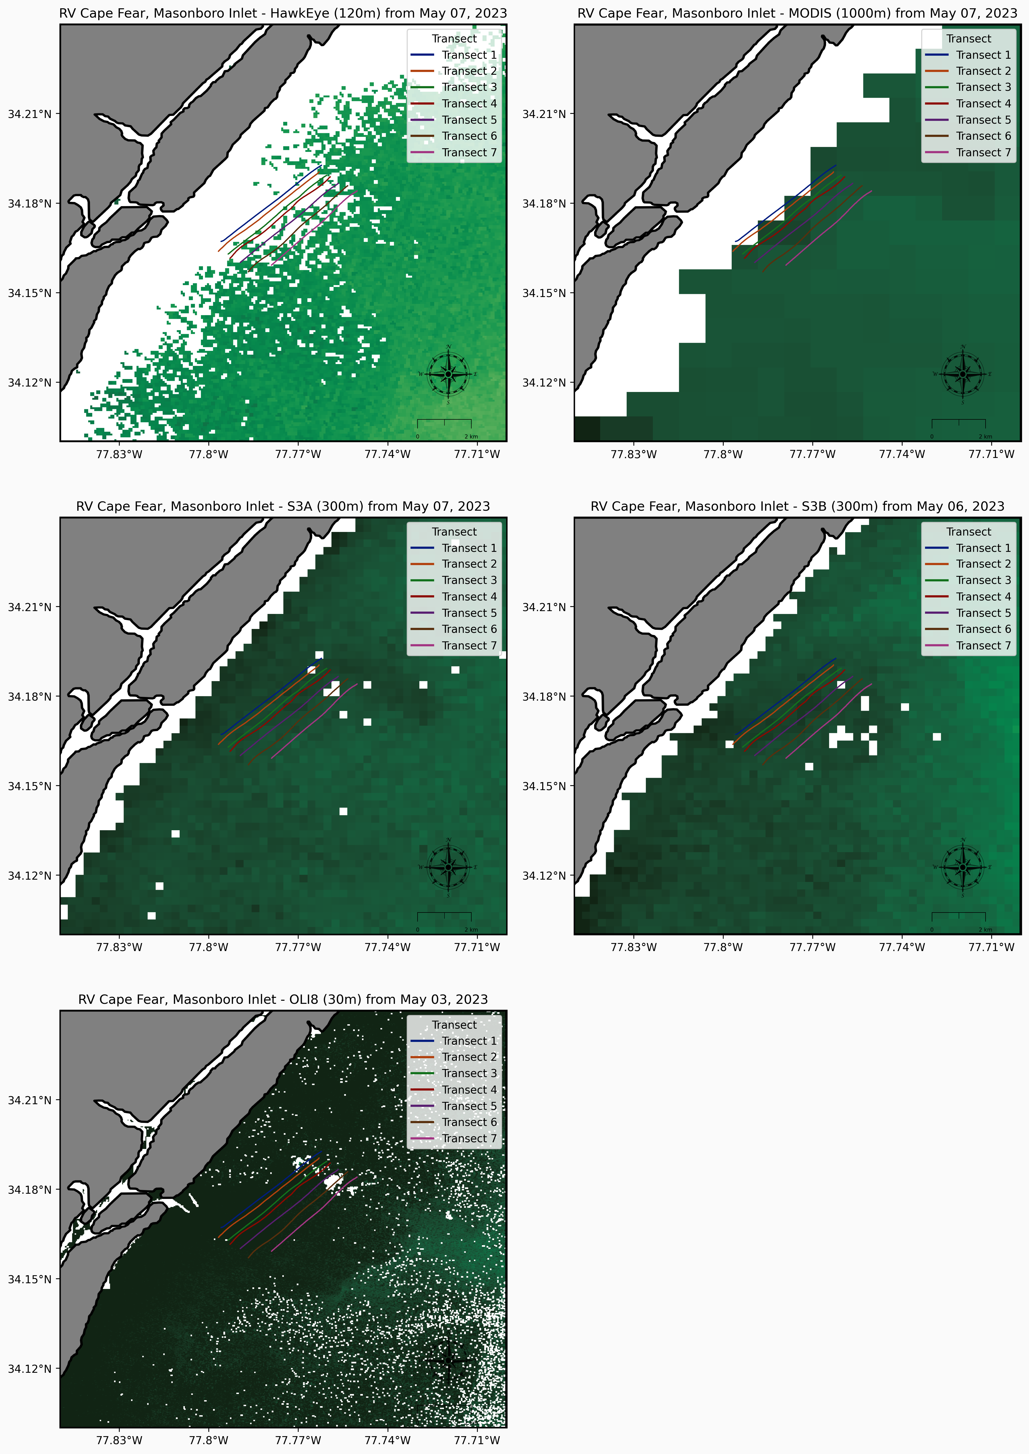
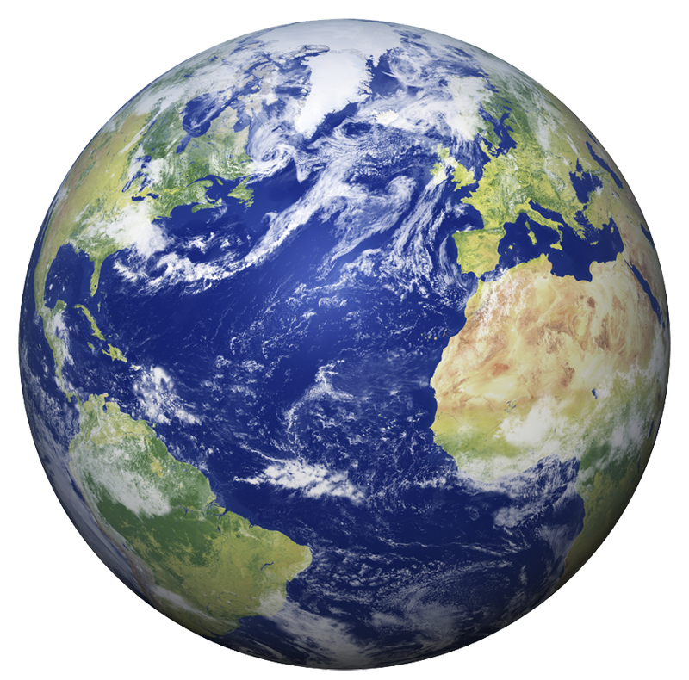
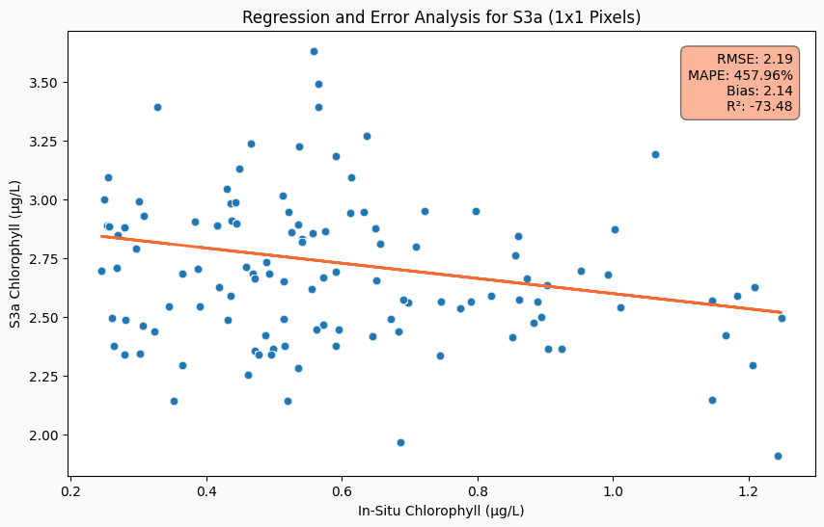
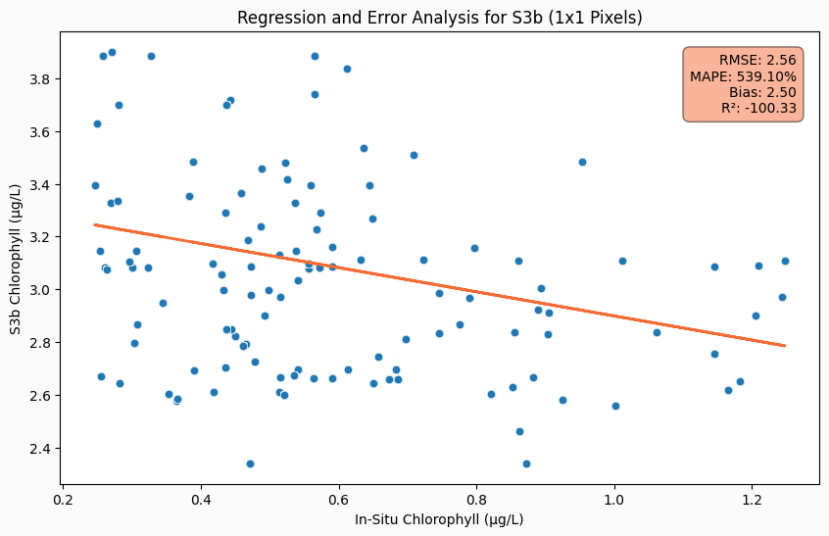
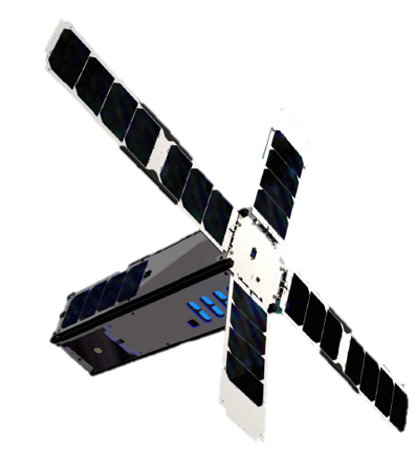
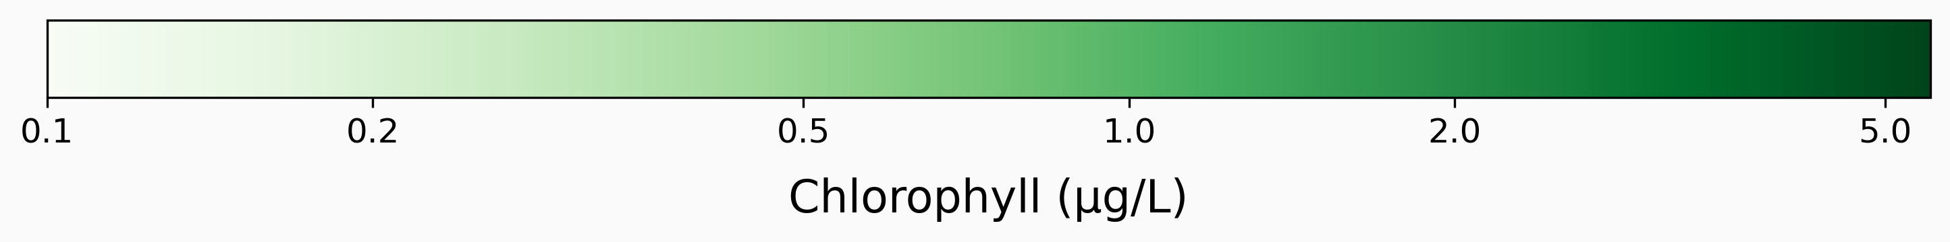




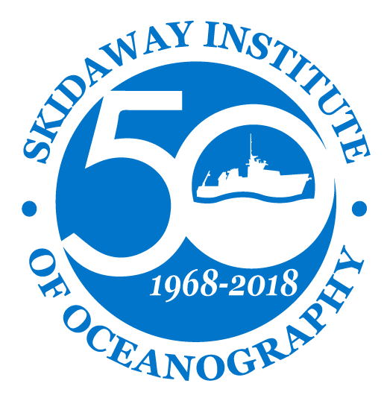
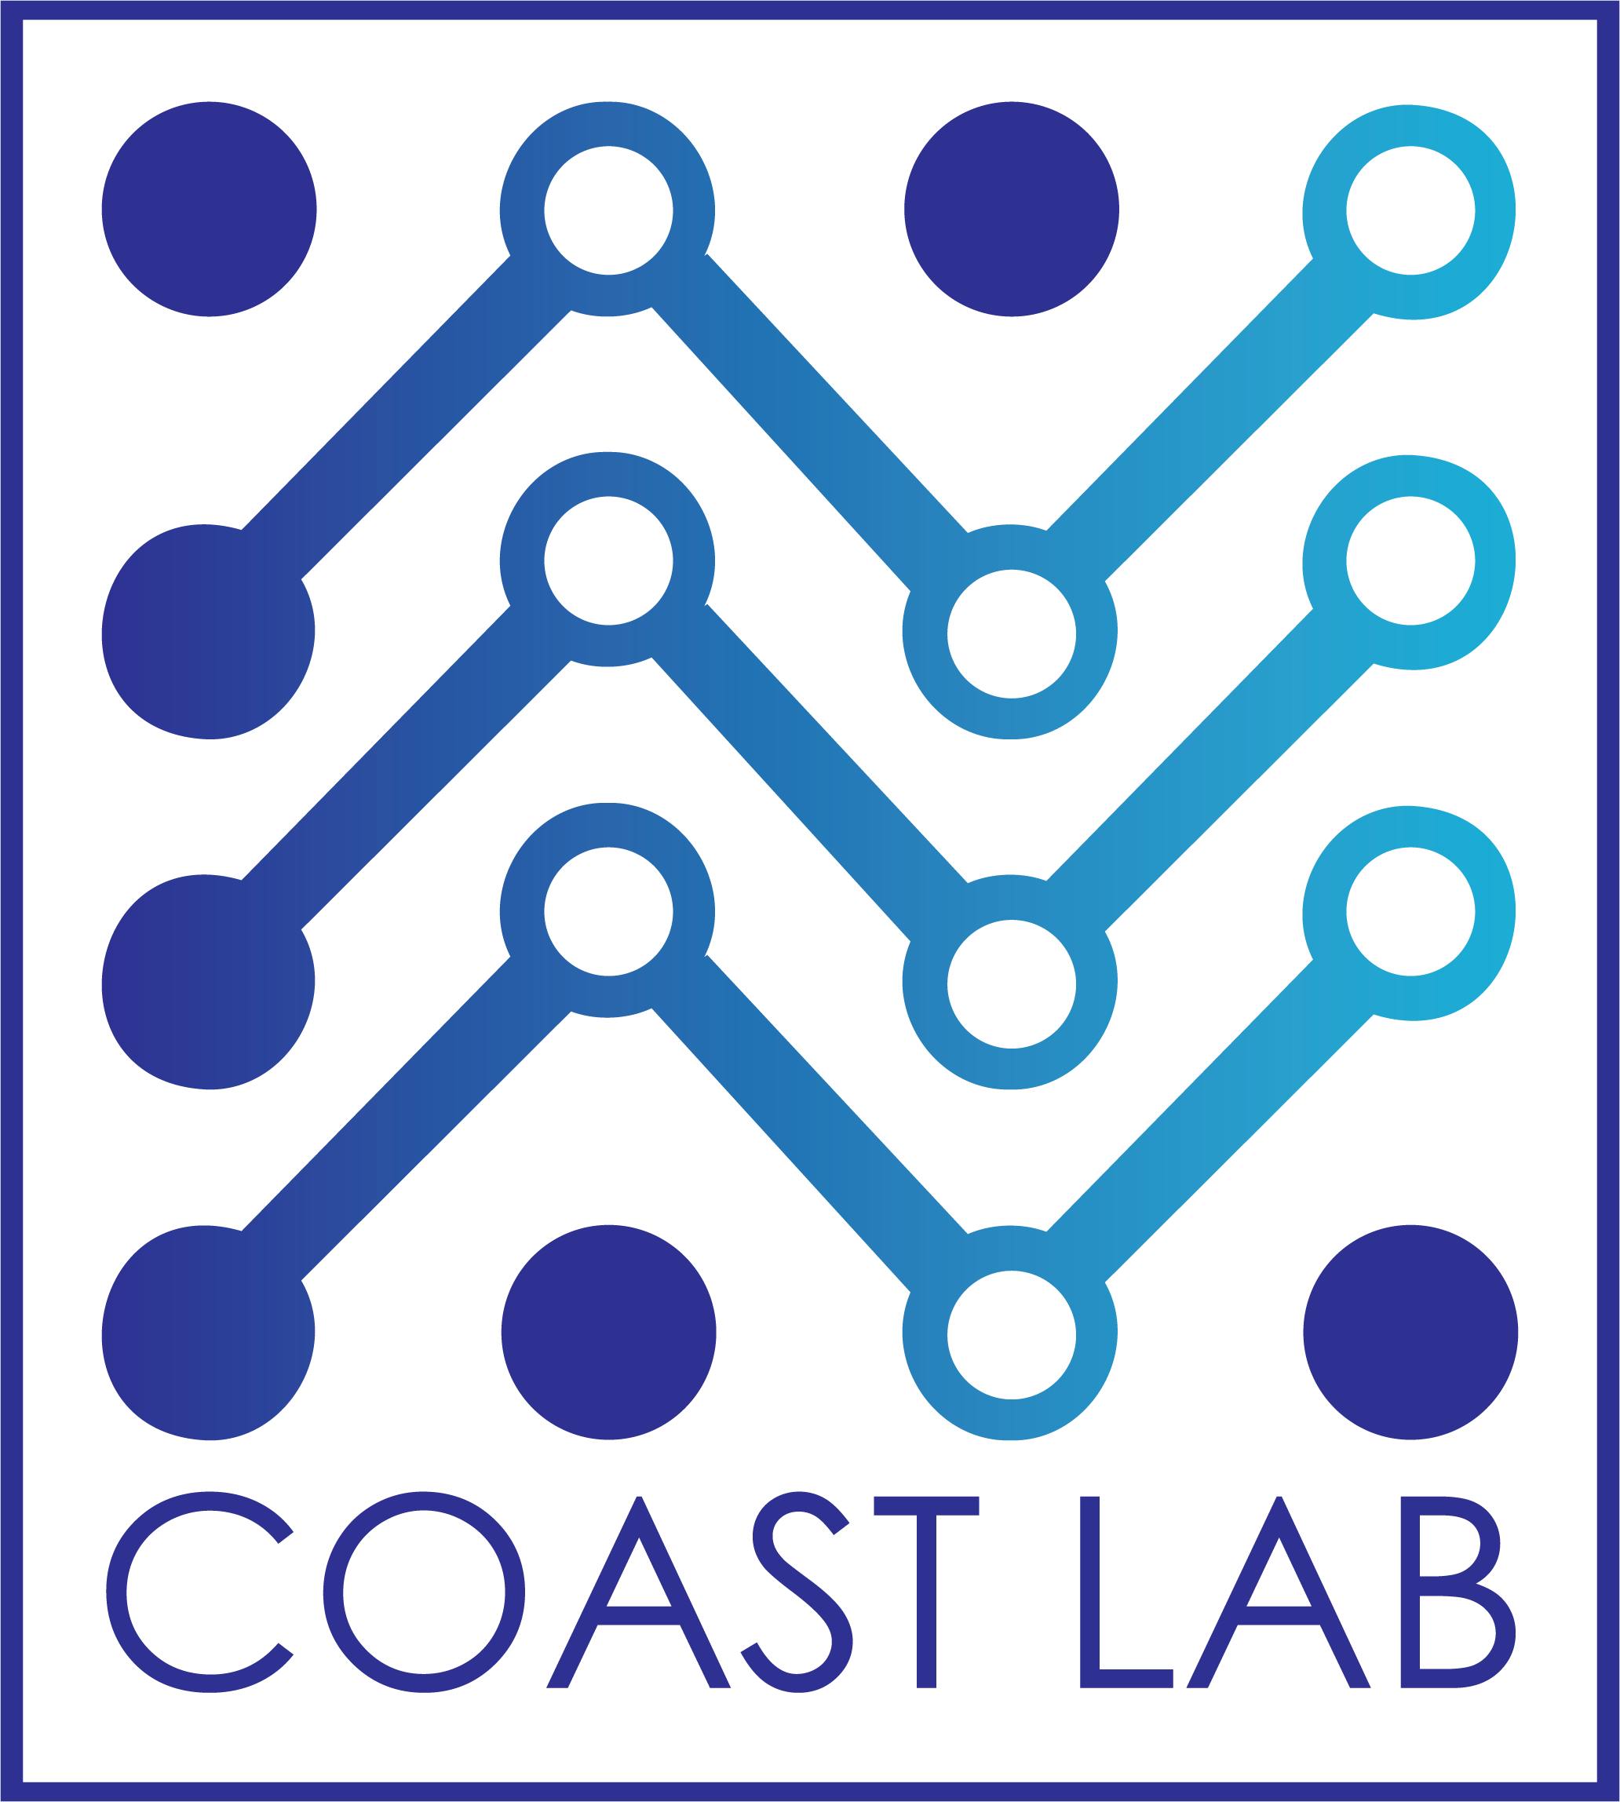

___–––+
HawkEye Ocean Color Imagery
UNCW LOGO
Evaluating Accuracy in Coastal Waters
Introduction
Challenges of Remote Sensing in Coastal Zones
This research evaluates the HawkEye satellite sensor's ability to capture ocean color imagery in the Cape Fear River Estuary, highlighting the challenges of studying optically complex waters for marine conservation.
Remote sensing in coastal regions is complex due to the dynamic interplay of light, particulate matter, and water constituents, impacting the accuracy of satellite imagery. The heterogeneity of coastal waters, influenced by factors such as sediment resuspension and terrestrial runoff, poses significant challenges for monitoring and algorithm development. Despite the broad coverage of remote sensing, its accuracy, especially in the coastal context, necessitates continual in-situ validation to understand and manage these ecologically critical zones effectively.
Objectives
Study Site – Masonboro Inlet
In-Situ Sampling
Sea-Truthing Data Collection: Implement rigorous in-situ sampling in the Cape Fear River Estuary to gather three-dimensional water quality data.
Comparative Analysis: Evaluate the performance of HawkEye's ocean color imagery against traditional satellite sensors and correlate findings with in-situ measurements.
Spatial Variability Investigation: Assess the distribution and concentration variability of chlorophyll within the estuary to better understand the spatial patterns of marine productivity.
Accuracy Assessment: Conduct a comprehensive matchup analysis to determine the accuracy of satellite-derived chlorophyll measurements in capturing the true biogeochemical state of coastal waters.
The Inlet, a part of North Carolina’s National Estuarine Research Reserve, is crucial for coastal stewardship and marine research. Its jetties influence sediment dynamics and shoreline changes, which are vital for the local ecology. The inlets waters and surrounds habitats support diverse wildlife, including important fish nurseries and protected species like sea turtles and shorebirds. The inlet, remaining naturally dynamic, provides essential insights for coastal management and conservation efforts.
Utilizing the Acrobat, we conducted seven transects on May 5, 2023, at the mouth of the inlet. Each transect was 4.5 km long, extending up to 4.5 km offshore. The Acrobat goes up and down in the water like a yo-yo, as it is pulled behind the vessel. This approach enables chlorophyll measurements throughout the first 10 meters of the water column.
Sea Sciences Inc: Acrobat
––
Water Column Variability
NASA Ocean Color
The water column in coastal areas like Masonboro Inlet is vertically heterogenous, characterized by varying conditions such as temperature, salinity, and nutrient concentrations at different depths, driven by factors like sunlight penetration, freshwater inflows, and tidal mixing. This stratification is vital for the ecological health of the estuary, influencing the distribution and behavior of marine life.
~300 m
Satellite Data Acquisition
Marinas.com: Masonboro Inlet
Satellite imagery was sourced from multiple platforms including MODIS Aqua, Sentinel 3A and 3B OLCI, Landsat 8 OLI, and SeaHawk HawkEye, focusing on the Lower Cape Fear River Estuary and Masonboro Inlet vicinity. We utilized the Ocean Color Web for data acquisition, processing level-1A TOA sensor readings into level-3 remote sensing reflectance products using SeaDAS software, applying quality control flags to ensure data reliability.
Preliminary Satellite Data Analysis
Initial regression analysis shows varying degrees of correlation between satellite and in situ chlorophyll measurements. While some satellite data align moderately with ground truth (e.g., Hawkeye), others exhibit substantial deviations, as indicated by high Mean Absolute Percentage Error (MAPE) and low R² values. These discrepancies underscore the challenges in satellite-based chlorophyll estimation, potentially due to atmospheric interference, sensor accuracy, or the complex nature of coastal waters.
Acknowledgements and Coauthors
Dr. Philip Bresnahan, University of North Carolina-Wilmington
Dr. Sara Rivero-Calle, UGA Skidaway Institute of Oceanography
Dr. Bob Brewin, University of Exeter
Dr. Bruce Monger, Cornell University
Thanks to the advisory committee and all who have supported this research.

